Slide 1
Software Engineering
Topic 9
Estimation for Software Project and
Project Scheduling

Slide 2
Acknowledgement
These slides have been adapted from
Pressman, R.S. (2015). Software Engineering : A Practioner's Approach. 8th ed. McGraw-Hill Companies.Inc, Americas, New York. ISBN : 978 1 259 253157. Chapter 33 and 34

Slide 3
Learning Objectives
LO 4 : Analyze the software project management

Slide 4
Contents
Software Project Planning
Software Scope
Resources
Project Estimation
Empirical Estimation Models
Estimation for OO Projects
Estimation for Agile Projects
The Make-Buy Decision
Project Scheduling
Earned Value Analysis (EVA)

Slide 5
Software Project Planning
The overall goal of project planning is to establish a pragmatic strategy for controlling, tracking, and monitoring a complex technical project.
Why?
So the end result gets done on time, with quality!

Slide 6
Software Project Planning
Project Planning Task Set-I
Establish project scope
Determine feasibility
Analyze risks
  Risk analysis is considered
Define required resources
  Determine require human resources
  Define reusable software resources
  Identify environmental resources

Slide 7
Software Project Planning
Project Planning Task Set-II
Estimate cost and effort
  Decompose the problem
  Develop two or more estimates using size, function points, process tasks or use-cases
  Reconcile the estimates
Develop a project schedule
  Scheduling is considered
    Establish a meaningful task set
    Define a task network
    Use scheduling tools to develop a timeline chart
    Define schedule tracking mechanisms

Slide 8
Software Project Planning
Estimation
Estimation of resources, cost, and schedule for a software engineering effort requires
  experience
  access to good historical information (metrics)
  the courage to commit to quantitative predictions when qualitative information is all that exists
Estimation carries inherent risk and this risk leads to uncertainty

Slide 9
Software Project Planning
Write it Down!
Project scope
Estimates
Risks
Schedule
Control strategy
Software
Project
Plan

Slide 10
Software Scope
To Understand Scope
Understand the customers needs
understand the business context
understand the project boundaries
understand the customer’s motivation
understand the likely paths for change
understand that ...
Even when you understand,
nothing is guaranteed!

Slide 11
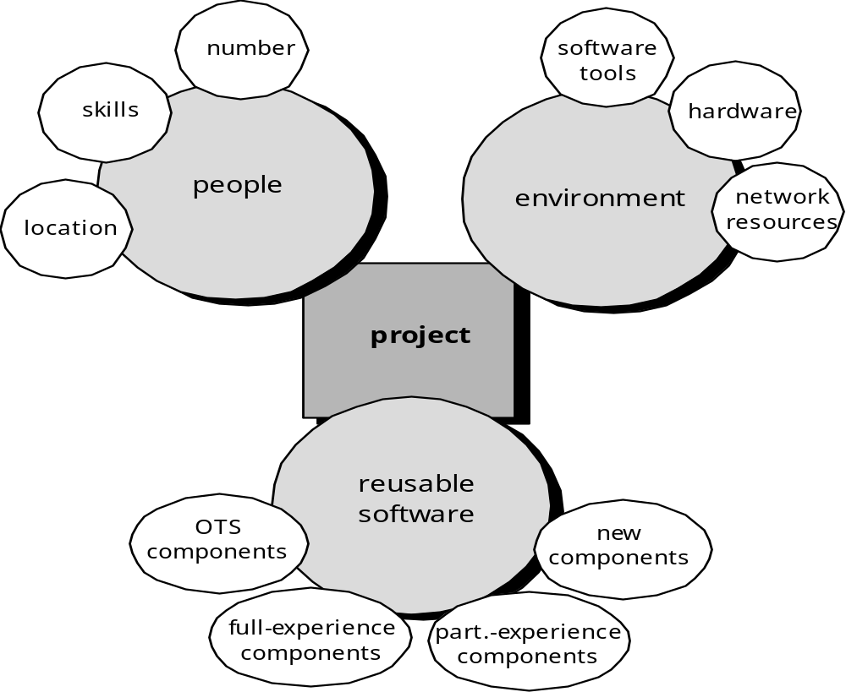
Resources

Slide 12

Project Estimation
Project scope must be understood
Elaboration (decomposition) is necessary
Historical metrics are very helpful
At least two different techniques should be used
Uncertainty is inherent in the process

Slide 13
Project Estimation
Estimation Accuracy
Predicated on …
  the degree to which the planner has properly estimated the size of the product to be built
  the ability to translate the size estimate into human effort, calendar time, and dollars (a function of the availability of reliable software metrics from past projects)
  the degree to which the project plan reflects the abilities of the software team
  the stability of product requirements and the environment that supports the software engineering effort.

Slide 14

Project Estimation
Estimation Techniques
Past (similar) project experience
Conventional estimation techniques
  task breakdown and effort estimates
  size (e.g., FP) estimates
Empirical models
Automated tools

Slide 15
Project Estimation
Functional Decomposition
Statement
of
Scope
functional
decomposition
Perform a Grammatical “parse”

Slide 16
Project Estimation
Conventional Methods:
LOC/FP Approach
compute LOC/FP using estimates of information domain values
use historical data to build estimates for the project

Slide 17
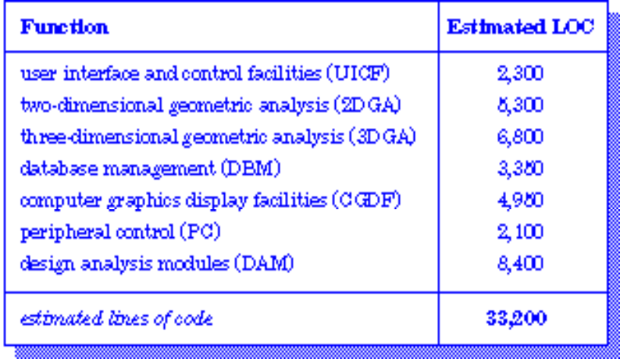
Project Estimation
Example: LOC Approach
Average productivity for systems of this type = 620 LOC/pm.
Burdened labor rate =$8000 per month, the cost per line of code is approximately $13.
Based on the LOC estimate and the historical productivity data, the total estimated project cost is $431,000 and the estimated effort is 54 person-months.

Slide 18
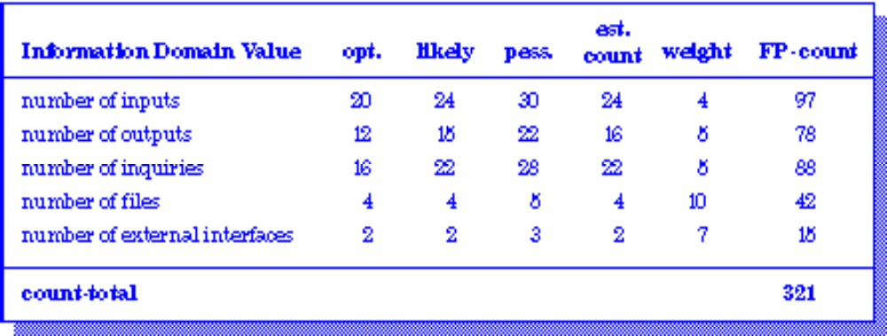
Project Estimation
Example: FP Approach
The estimated number of FP is derived:
FP_{estimated} = count-total x [0.65 + 0.01 x Σ (F_{i})]
FP_{estimated} = 375
organizational average productivity = 6.5 FP/pm.
burdened labor rate = $8000 per month, approximately $1230/FP.
Based on the FP estimate and the historical productivity data, total estimated project cost is $461,000 and estimated effort is 58 person-months.

Slide 19
Project Estimation
Process-Based Estimation
Obtained from “process framework”
framework activities
application
functions
Effort required to accomplish
each framework activity for each application function

Slide 20
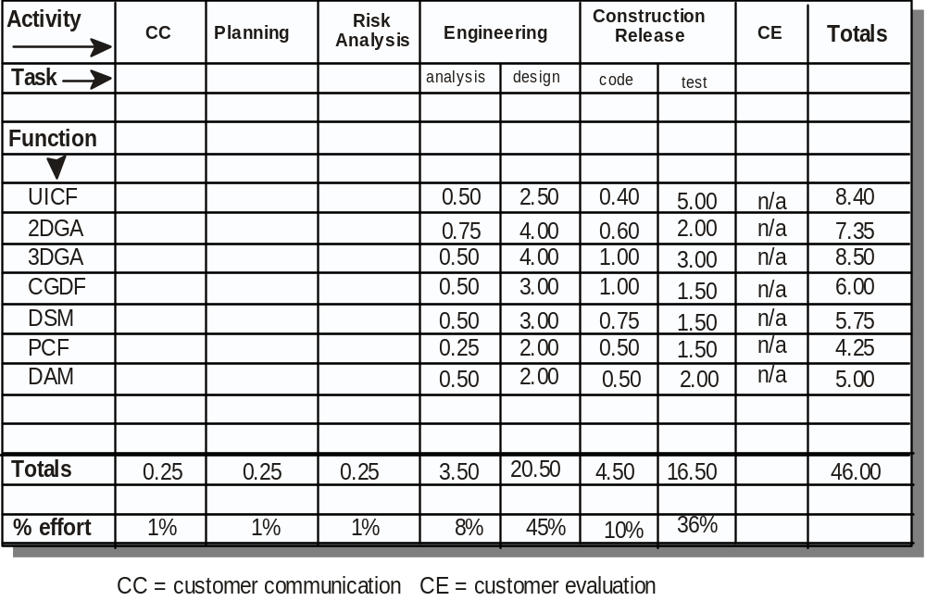
Project Estimation
Process-Based Estimation Example
Based on an average burdened labor rate of $8,000 per month, the total estimated project cost is $368,000 and the estimated effort is 46 person-months.

Slide 21

Project Estimation
Tool-Based Estimation
project characteristics
calibration factors
LOC/FP data

Slide 22
Empirical Estimation Models
General form:
exponent
effort = tuning coefficient * size
usually derived
empirically
as person-months
derived
of effort required
usually LOC but
may also be
either a constant or
function point
a number derived based
on complexity of project

Slide 23
Empirical Estimation Models
COCOMO-II
COCOMO II is actually a hierarchy of estimation models that address the following areas:
    Application composition model. Used during the early stages of software engineering, when prototyping of user interfaces, consideration of software and system interaction, assessment of performance, and evaluation of technology maturity are paramount.
    Early design stage model. Used once requirements have been stabilized and basic software architecture has been established.
    Post-architecture-stage model. Used during the construction of the software.

Slide 24
Empirical Estimation Models
The Software Equation
A dynamic multivariable model
E = [LOC x B^{0.333}/P]³ x (1/t⁴)
where
E = effort in person-months or person-years
t = project duration in months or years
B = “special skills factor”
P = “productivity parameter”

Slide 25
Estimation for OO Projects
Develop estimates using effort decomposition, FP analysis, and any other method that is applicable for conventional applications.
Using object-oriented requirements modeling, develop use-cases and determine a count.
From the analysis model, determine the number of key classes.
Categorize the type of interface for the application and develop a multiplier for support classes:
  Interface type Multiplier
  No GUI 2.0
  Text-based user interface 2.25
  GUI 2.5
  Complex GUI 3.0

Slide 26
Estimation for OO Projects
Multiply the number of key classes (step 3) by the multiplier to obtain an estimate for the number of support classes.
Multiply the total number of classes (key + support) by the average number of work-units per class. Lorenz and Kidd suggest 15 to 20 person-days per class.
Cross check the class-based estimate by multiplying the average number of work-units per use-case

Slide 27
Estimation for Agile Projects
Each user scenario (a mini-use-case) is considered separately for estimation purposes.
The scenario is decomposed into the set of software engineering tasks that will be required to develop it.
Each task is estimated separately. Note: estimation can be based on historical data, an empirical model, or “experience.”
  Alternatively, the ‘volume’ of the scenario can be estimated in LOC, FP or some other volume-oriented measure (e.g., use-case count).
Estimates for each task are summed to create an estimate for the scenario.
  Alternatively, the volume estimate for the scenario is translated into effort using historical data.
The effort estimates for all scenarios that are to be implemented for a given software increment are summed to develop the effort estimate for the increment.

Slide 28
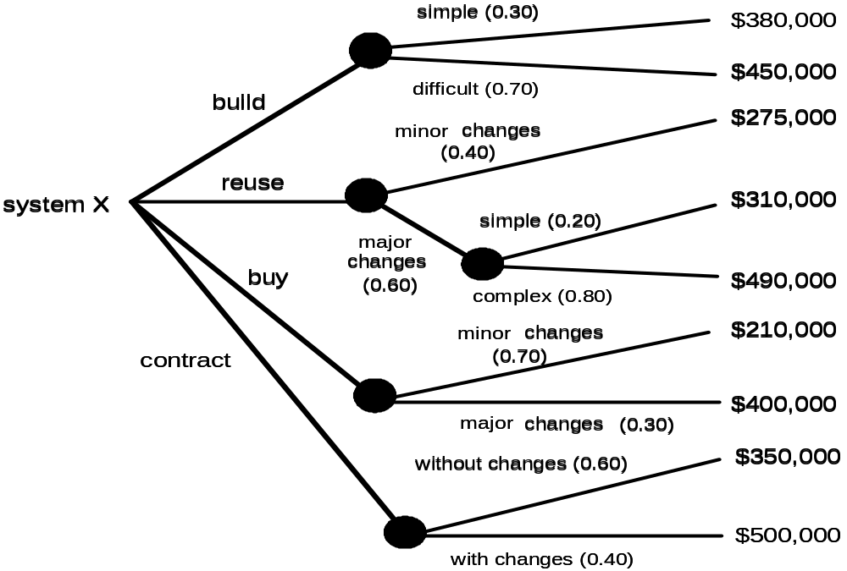
The Make-Buy Decision

Slide 29
The Make-Buy Decision
Computing Expected Cost
expected cost =
(path probability) x (estimated path cost)
i
i
For example, the expected cost to build is:
expected cost = 0.30 ($380K) + 0.70 ($450K)
build
= $429 K
similarly,
expected cost = $382K
reuse
expected cost = $267K
buy
expected cost = $410K

Slide 30
The Make-Buy Decision
Computing Expected Cost
expected cost =
(path probability) x (estimated path cost)
i
i
For example, the expected cost to build is:
expected cost = 0.30 ($380K) + 0.70 ($450K)
build
= $429 K
similarly,
expected cost = $382K
reuse
expected cost = $267K
buy
expected cost = $410K

Slide 31
Project Scheduling
Scheduling Principles
Compartmentalization —define distinct tasks
Interdependency —indicate task interrelationship
Effort validation —be sure resources are available
Defined responsibilities —people must be assigned
Defined outcomes —each task must have an output
Defined milestones —review for quality

Slide 32
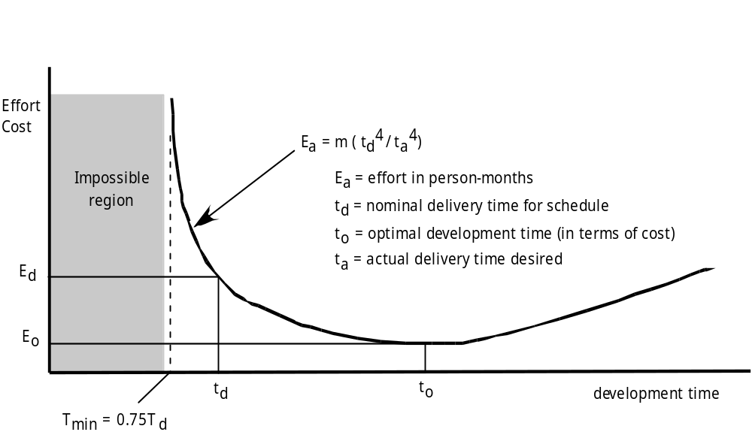
Project Scheduling
Effort and Delivery Time

Slide 33
Project Scheduling
Effort Allocation
“front end” activities
  customer communication
  analysis
  design
  review and modification
construction activities
  coding or code generation
testing and installation
  unit, integration
  white-box, black box
  regression
40-50%
15-20%
30-40%

Slide 34
Project Scheduling
Defining Task Sets
determine type of project
assess the degree of rigor required
identify adaptation criteria
select appropriate software engineering tasks

Slide 35
Project Scheduling
Task Set Refinement
1.1 Concept scoping determines the overall scope of the project.
Task definition: Task 1.1 Concept Scoping
1.1.1 Identify need, benefits and potential customers;
1.1.2 Define desired output/control and input events that drive the application;
Begin Task 1.1.2
1.1.2.1 FTR: Review written description of need
  FTR indicates that a formal technical review (Chapter 26) is to be conducted.
1.1.2.2 Derive a list of customer visible outputs/inputs
1.1.2.3 FTR: Review outputs/inputs with customer and revise as required;
endtask Task 1.1.2
1.1.3 Define the functionality/behavior for each major function;
Begin Task 1.1.3
1.1.3.1 FTR: Review output and input data objects derived in task 1.1.2;
1.1.3.2 Derive a model of functions/behaviors;
1.1.3.3 FTR: Review functions/behaviors with customer and revise as required;
endtask Task 1.1.3
1.1.4 Isolate those elements of the technology to be implemented in software;
1.1.5 Research availability of existing software;
1.1.6 Define technical feasibility;
1.1.7 Make quick estimate of size;
1.1.8 Create a Scope Definition;
endTask definition: Task 1.1
is refined to

Slide 36
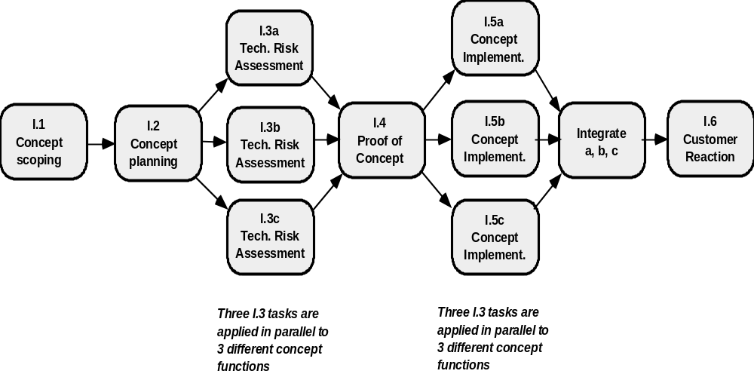
Project Scheduling
Define a Task Network

Slide 37
Project Scheduling
Timeline Charts
Tasks
Week 1
Week 2
Week 3
Week 4
Week n
Task 1
Task 2
Task 3
Task 4
Task 5
Task 6
Task 7
Task 8
Task 9
Task 10
Task 11
Task 12

Slide 38
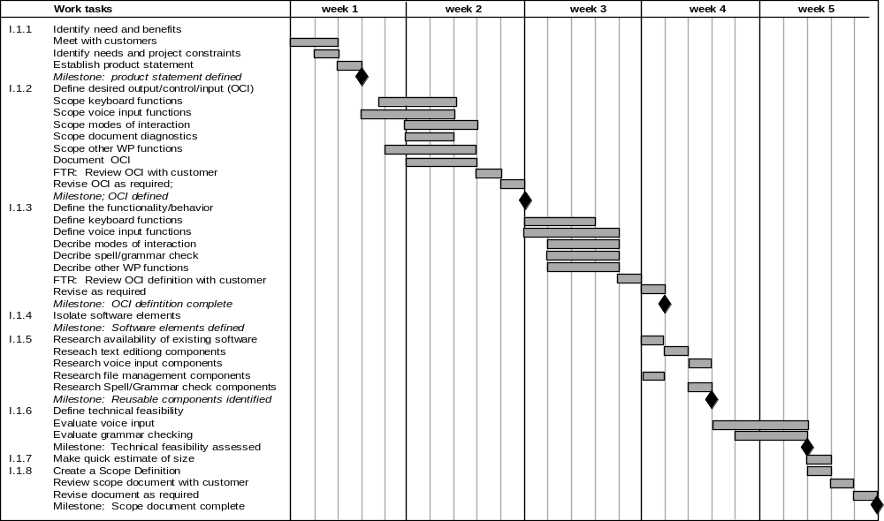
Project Scheduling
Use Automated Tools to Derive a Timeline Chart

Slide 39
Project Scheduling
Schedule Tracking
  conduct periodic project status meetings in which each team member reports progress and problems.
  evaluate the results of all reviews conducted throughout the software engineering process.
  determine whether formal project milestones have been accomplished by the scheduled date.
  compare actual start-date to planned start-date for each project task listed in the resource table.
  meet informally with practitioners to obtain their subjective assessment of progress to date and problems on the horizon.
  use earned value analysis to assess progress quantitatively.

Slide 40
Project Scheduling
Progress on an OO Project-I
Technical milestone: OO analysis completed
    All classes and the class hierarchy have been defined and reviewed.
    Class attributes and operations associated with a class have been defined and reviewed.
    Class relationships have been established and reviewed.
    A behavioral model has been created and reviewed.
    Reusable classes have been noted.
Technical milestone: OO design completed
    The set of subsystems has been defined and reviewed.
    Classes are allocated to subsystems and reviewed.
    Task allocation has been established and reviewed.
    Responsibilities and collaborations have been identified.
    Attributes and operations have been designed and reviewed.
    The communication model has been created and reviewed.

Slide 41
Scheduling for WebApp and Mobile Projects
Seven increments for Web and MobileApps
Basic company and product information
Detailed product information and downloads
Product quotes and processing product orders
Space layout and security system design
Information and ordering of monitoring srvices
Online control of monitoring equipment
Accessing control information

Slide 42
Scheduling for WebApp and Mobile Projects
Design the interface for the fourth increment
Develop a sketch of the page layout for the space design page
Review layout with stakeholders
Design space layout navigation mechanisms
Design “drawing board” layout
Develop procedural details for the graphical wall layout function
Develop procedural details for the wall length computation and display function
Develop procedural details for the graphical window layout function
Develop procedural details for the graphical door layout function
Design mechanisms for selecting security system components

Slide 43
Project Scheduling
Progress on an OO Project-II
Technical milestone: OO programming completed
    Each new class has been implemented in code from the design model.
    Extracted classes (from a reuse library) have been implemented.
    Prototype or increment has been built.
Technical milestone: OO testing
    The correctness and completeness of OO analysis and design models has been reviewed.
    A class-responsibility-collaboration network has been developed and reviewed.
    Test cases are designed and class-level tests have been conducted for each class.
    Test cases are designed and cluster testing is completed and the classes are integrated.
    System level tests have been completed.

Slide 44
Earned Value Analysis (EVA)
Earned value
  is a measure of progress
  enables us to assess the “percent of completeness” of a project using quantitative analysis rather than rely on a gut feeling
  “provides accurate and reliable readings of performance from as early as 15 percent into the project.” [Fle98]

Slide 45
Earned Value Analysis (EVA)
Computing Earned Value-I
The budgeted cost of work scheduled (BCWS) is determined for each work task represented in the schedule.
  BCWS_{i} is the effort planned for work task i.
  To determine progress at a given point along the project schedule, the value of BCWS is the sum of the BCWS_{i} values for all work tasks that should have been completed by that point in time on the project schedule.
The BCWS values for all work tasks are summed to derive the budget at completion, BAC. Hence,
BAC = ∑ (BCWS_{k}) for all tasks k

Slide 46
Earned Value Analysis (EVA)
Computing Earned Value-II
Next, the value for budgeted cost of work performed (BCWP) is computed.
  The value for BCWP is the sum of the BCWS values for all work tasks that have actually been completed by a point in time on the project schedule.
“the distinction between the BCWS and the BCWP is that the former represents the budget of the activities that were planned to be completed and the latter represents the budget of the activities that actually were completed.” [Wil99]
Given values for BCWS, BAC, and BCWP, important progress indicators can be computed:
  Schedule performance index, SPI = BCWP/BCWS
  Schedule variance, SV = BCWP – BCWS
  SPI is an indication of the efficiency with which the project is utilizing scheduled resources.

Slide 47
Earned Value Analysis (EVA)
Computing Earned Value-III
Percent scheduled for completion = BCWS/BAC
  provides an indication of the percentage of work that should have been completed by time t.
Percent complete = BCWP/BAC
  provides a quantitative indication of the percent of completeness of the project at a given point in time, t.
Actual cost of work performed, ACWP, is the sum of the effort actually expended on work tasks that have been completed by a point in time on the project schedule. It is then possible to compute
    Cost performance index, CPI = BCWP/ACWP
    Cost variance, CV = BCWP – ACWP

Slide 48
Case Study
The use of project management tools
In practical project, the use of project management tools are very effective to manage the project process including:
  Scheduling
  Resources
  Estimation
  Costing
  etc

Slide 49
References
Pressman, R.S. (2015). Software Engineering : A Practioner's Approach. 8th ed. McGraw-Hill Companies.Inc, Americas, New York. ISBN : 978 1 259 253157.
IT and sw estimation
http://www.charismatek.com/_public4/html/services/service_estimation.htm
Overview of COCOMO
http://www.softstarsystems.com/overview.htm
Function Point Language
http://www.qsm.com/resources/function-point-languages-table/index.html
PERT
http://en.wikipedia.org/wiki/Program_Evaluation_and_Review_Technique

Slide 50
Q & A

